Slide 1

Moneyclip Mobile localization
April 26, 2013
Team Panda
Blayne Kennedy, Kimberly Oyama, Daren Rodhouse, Chihiro Sasaki

Slide 2
overview
Solution Overview
Design
Implementation
Testing
Conclusion

Slide 3
Solution Overview
Design
Implementation
Process
Testing
Conclusion
Design
Daren Rodhouse

Slide 4
Solution Overview
Design
Implementation
Process
Testing
Conclusion
Design
Daren Rodhouse

Slide 5
Solution Overview
Design
Implementation
Process
Testing
Conclusion
Process
Daren Rodhouse

Slide 6
Solution Overview
Design
Implementation
Process
TESTING
Conclusion
Design
Daren Rodhouse

Slide 7
Solution Overview
Design
Implementation
Process
Testing
CONCLUSION
Design
Daren Rodhouse

Slide 8

Our Client
Joshua Cross
Founder, CEO at Hermes Commerce, Inc.
Application Development
Notes:
kimi

Slide 9
Problem Statement
We want:
Moneyless transactions similar to PayPal
Mobile transactions like Square
Use location-based targeted deals
Notes:
kimi

Slide 10


Solution Overview
Direct Ads
+
Notes:
Connect merchant and customer so the merchant can charge the customer.
Use previous transactions, demographics, and user location for targeted advertising.
Kimi
Your vision: was it compelling, did it evoke confidence
and suggest creativity? Did it get us motivated to listen to the rest of the talk?
Your vision. Should address precisely the problems you just
mentioned. Grading: was it compelling, did it evoke confidence and suggest creativity?
Did it get us motivated to listen to the rest of the talk?

Slide 11
Solution Overview
Design
Implementation
Process
Testing
Conclusion
Design
Daren Rodhouse

Slide 12
Requirements Elicitation
Group Brainstorming
Group consensus
Compose questions
Initial Client Meeting
Lay out group's understanding of project
Client molds understanding
Follow-Up Client Meetings
Go over requirements document
Notes:
Daren
risks
Privacy protection on apps
Content filter
No cell service
Inaccurate geolocation
MCM server failure

Slide 13
Functional requirements
Customer/Merchant Interfaces
Mobile devices
Website
Basic functionality
Request/accept payment
Change settings
Ads, coupons, location, account
Merchant map
Notes:
daren

Slide 14
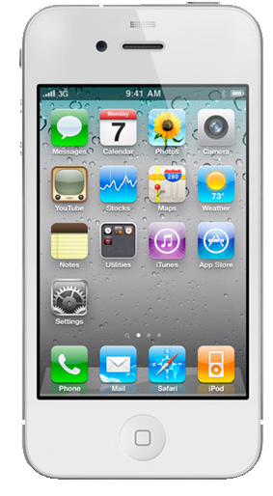
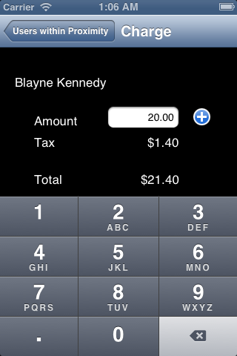


Functional requirements
Customer/Merchant apps must communicate with each other
Merchant charges customer
Customer is notified
Customer replies
2
1
Server
3

Slide 15
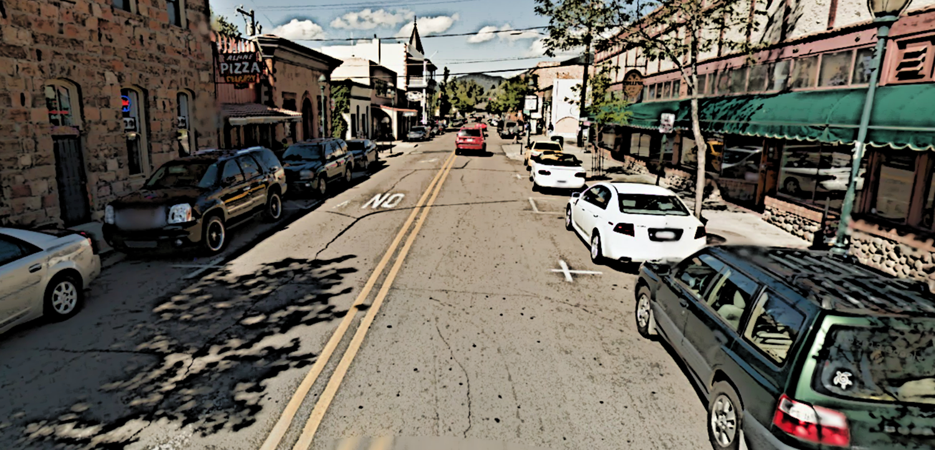
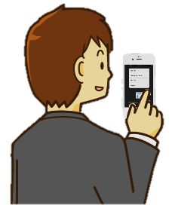
Functional requirements
Meaningful Advertisements
Pushed based on location/demographic
user inputs destination
user gets notification about ads/coupons from nearby locations and subscribed merchants nearby

Slide 16
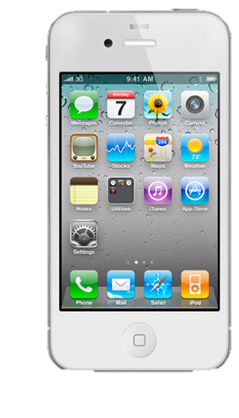
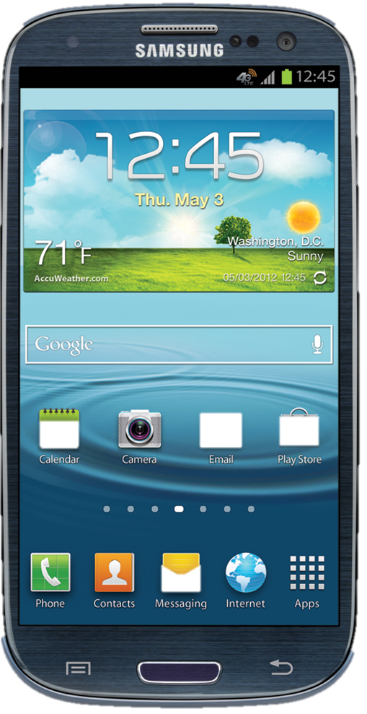
Non-Functional Requirements
Cross-platform
Usability
Reliability
Performance
Accessibility
Scalability
Notes:
daren

Slide 17
Environmental requirements
Android Devices
Operating System Fragmentation
Java and XML
iPhone Devices
Objective-C
Google Maps API
Timely Advertisements
Notes:
Daren

Slide 18
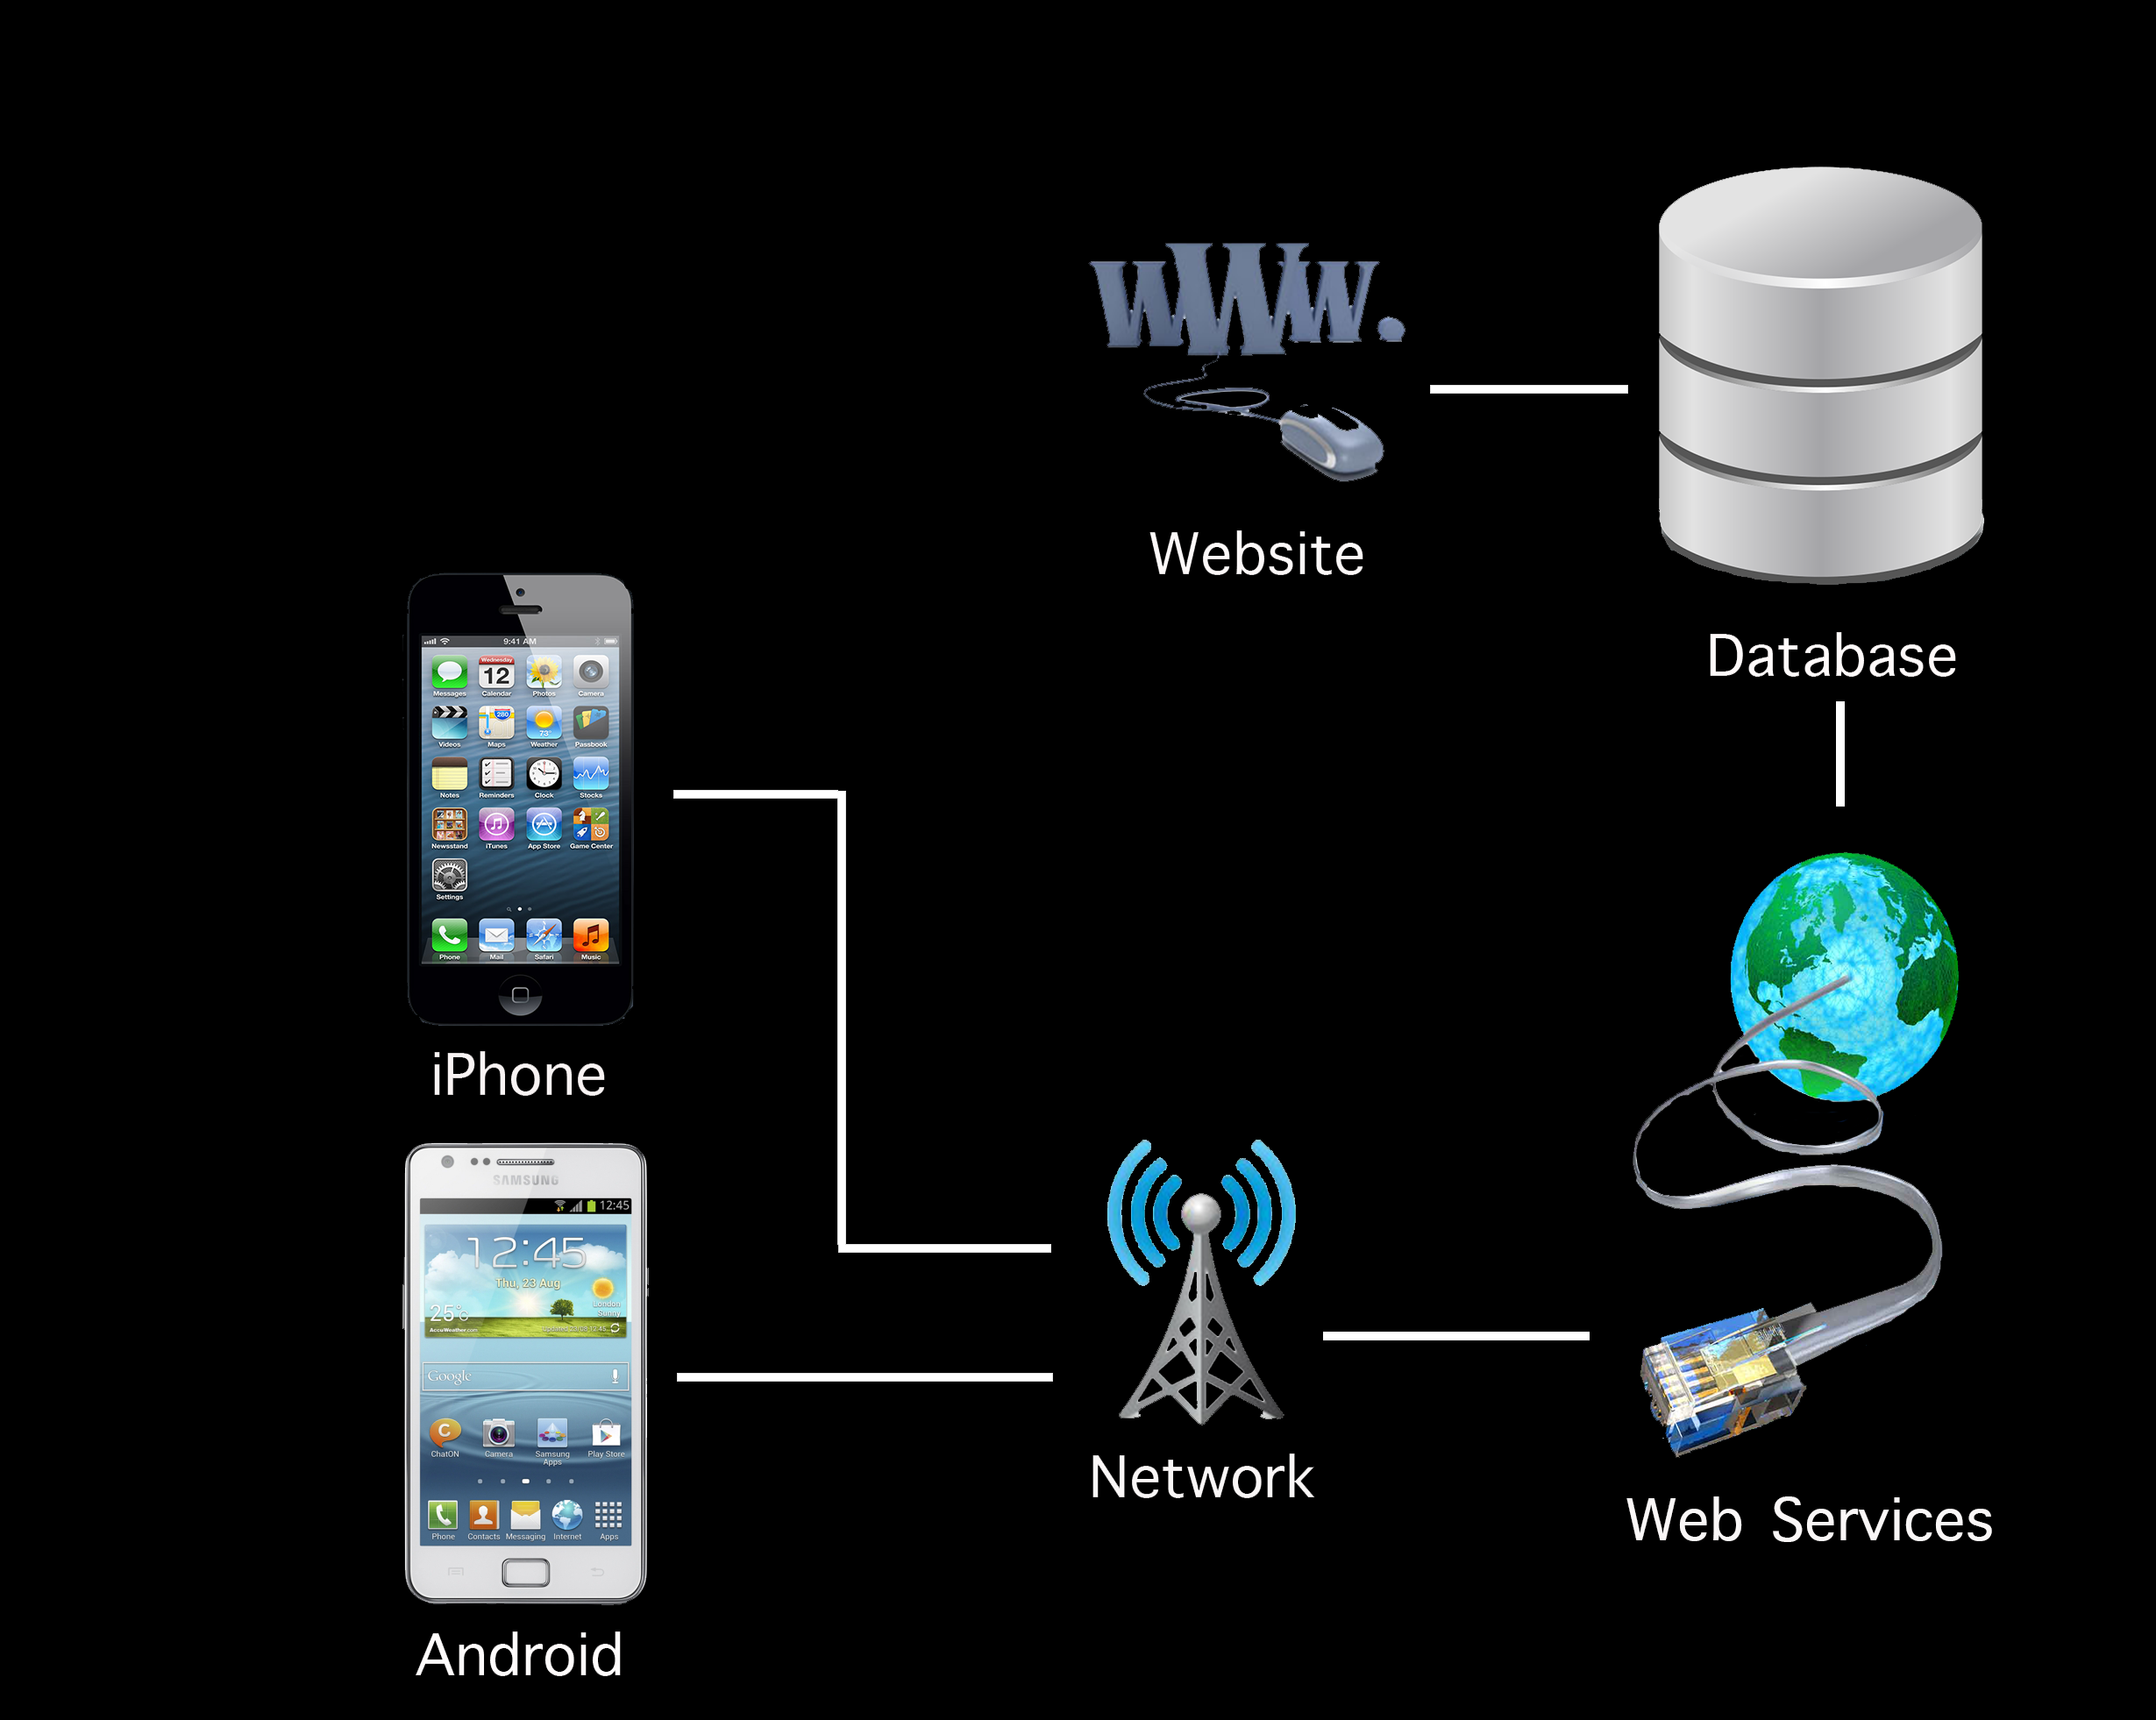
Architecture Overview
Notes:
Blayne
Sketch out the architecture to show us how you're tackling
the problem; intro and briefly describe each main component of your system.

Slide 19
Technology Overview
Target Platforms
Android 4.2
iOS 5
Localization
Google Maps API
Network provider or GPS
Server
RESTful Web Services
MySQL
Notes:
Blayne
Should be focal point of this presentation. Review
progress implementing various parts of the architecture previewed above --- hopefully
more or less DONE at this point. Give demos or screenshots where appropriate.

Slide 20
Localization
Connection between Merchant and customer
Database
SQL Queries
SQL Response
Merchant App
HTTP Request
RESTful Web Service
HTTP Request
CustomerApp
JSON
JSON
Notification service
Notification service
Notes:
The first core functionality of localization is the connection between the merchant and the customer in the store.
When the customer walks into the store, they are able to update their location, which happens as an HTTP Request to the web service, where information is sent as a JSON string. Next, the merchant is notified of the customer in the store. When a purchase is going to be made, the merchant can push a charge to the customer. This charge goes through the web service, updates the database, and the user is then notified of a new charge. The customer can then approve or decline the charge, depending on the situation, and this information is again sent to the web service, and the merchant can confirm that the charge has been made.
Google Cloud Messaging
Apple Push Notification Service

Slide 21
localization
Directed advertisement depending on localization
Database
SQL Queries
SQL Response
RESTful Web Service
CustomerApp
Update location via HTTP connection
JSON
Notification of ads/coupons
Notes:
The second key aspect of localization is the directed advertisements and coupons.
The customer’s location is periodically updated through an HTTP connection. The web service then calculates nearby merchants that the user is subscribed to and relevant coupons and advertisements are sent to the user’s phone. This increases the chance of users taking advantage of special offers that are being held at nearby stores.

Slide 22
Solution Overview
Design
Implementation
Testing
Conclusion
Implementation
Daren Rodhouse & Blayne Kennedy

Slide 23


PART 1: merchant - customer interaction

Slide 24
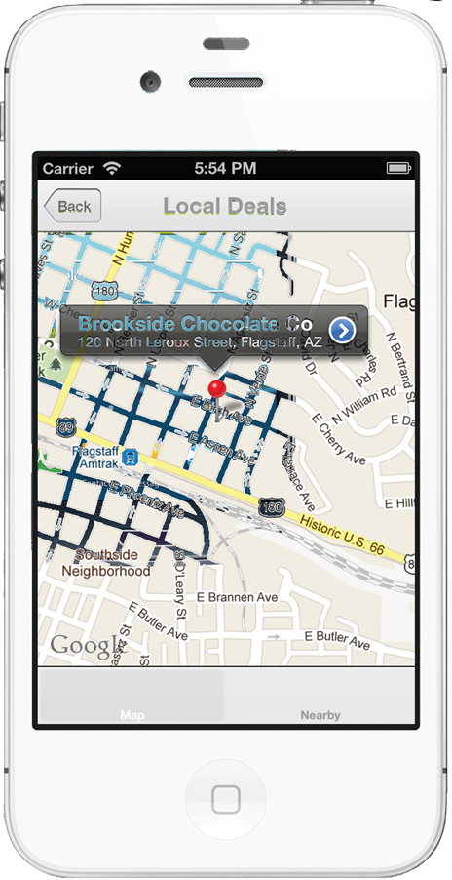
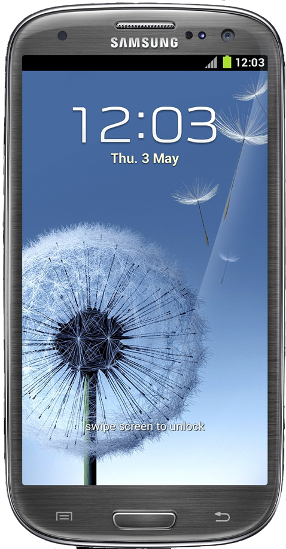
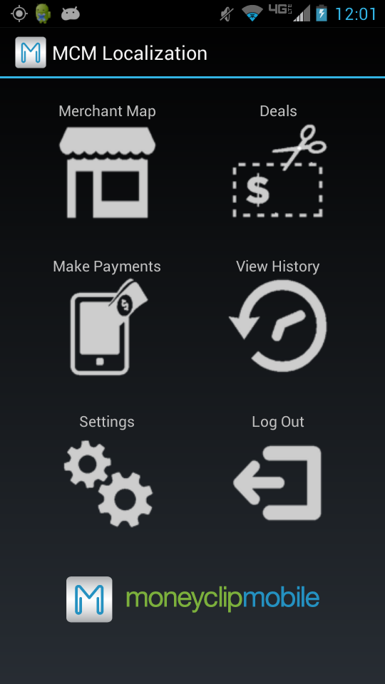
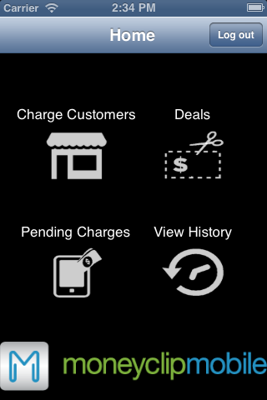
Customer - merchant interaction
Merchant
Customer
Notes:
CHIHI

Slide 25
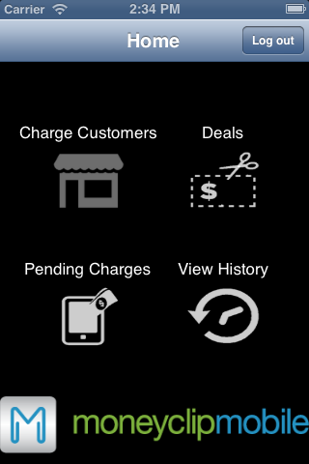
Customer - merchant interaction
Merchant
Customer
Notes:
CHIHI

Slide 26
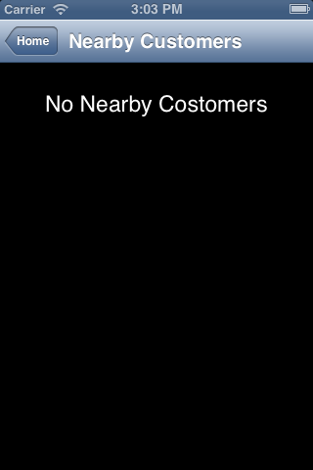
Customer - merchant interaction
Merchant
Customer
Notes:
CHIHI

Slide 27
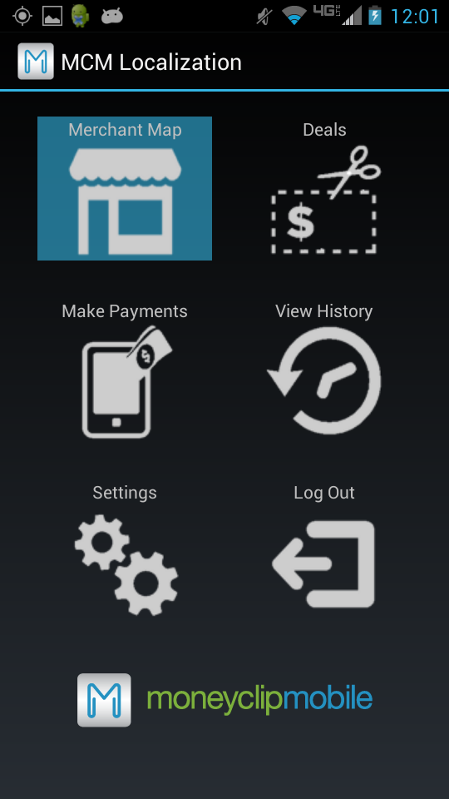
Customer - merchant interaction
Merchant
Customer
Notes:
CHIHI

Slide 28
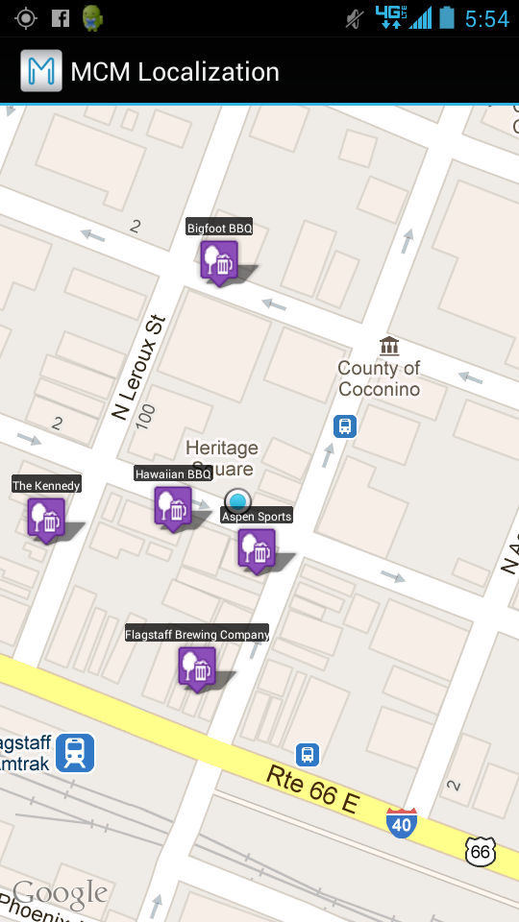
Customer - merchant interaction
Merchant
Customer
Notes:
CHIHI

Slide 29
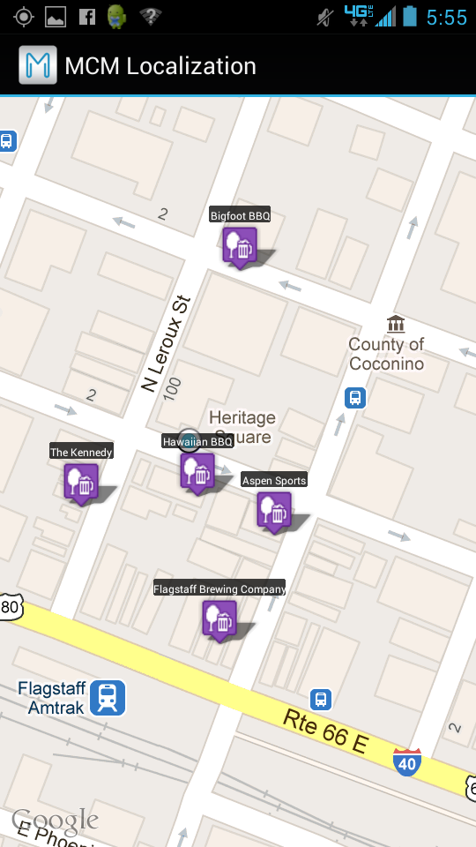
Customer - merchant interaction
Merchant
Customer
Notes:
CHIHI

Slide 30
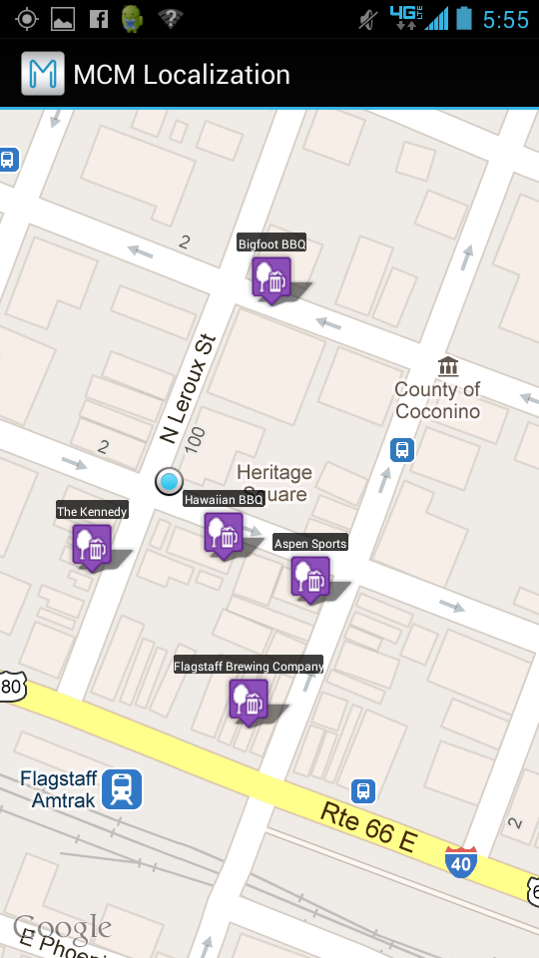
Customer - merchant interaction
Merchant
Customer
Notes:
CHIHI

Slide 31
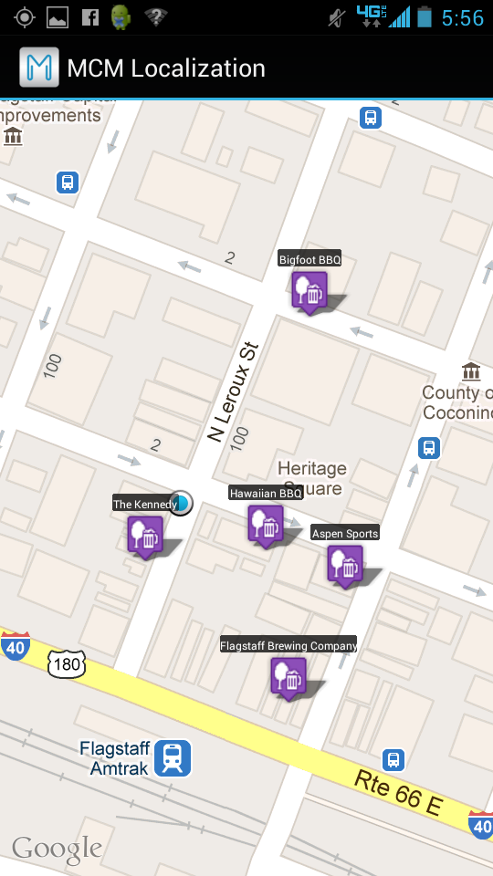
Customer - merchant interaction
Merchant
Customer
Notes:
CHIHI

Slide 32

Customer - merchant interaction
Merchant
Customer
Notes:
CHIHI

Slide 33
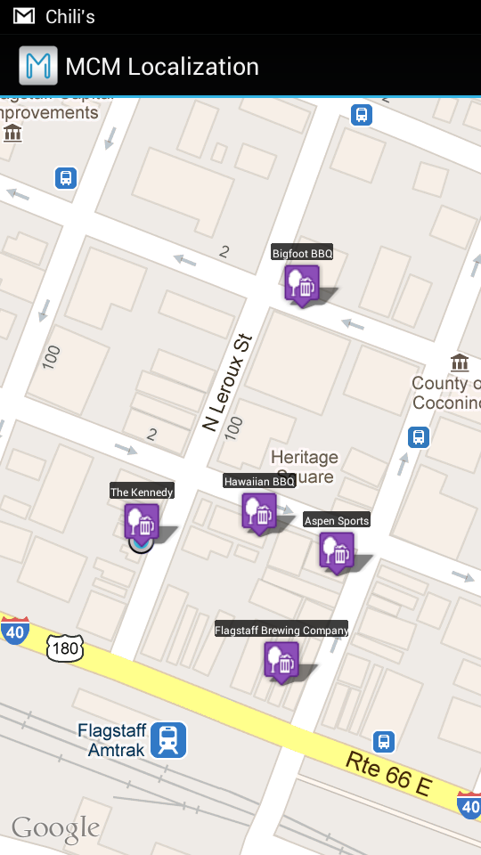
Customer - merchant interaction
Merchant
Customer
Notes:
CHIHI

Slide 34
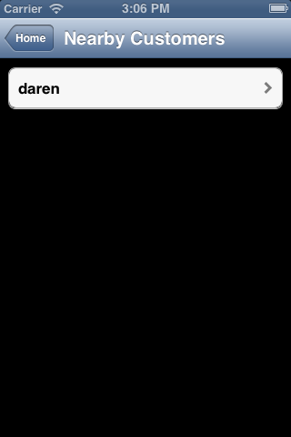
Customer - merchant interaction
Merchant
Customer
Notes:
CHIHI

Slide 35
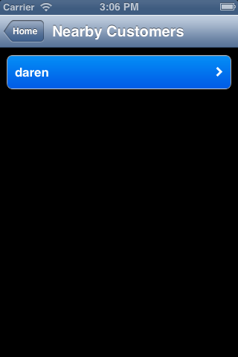
Customer - merchant interaction
Merchant
Customer
Notes:
CHIHI

Slide 36
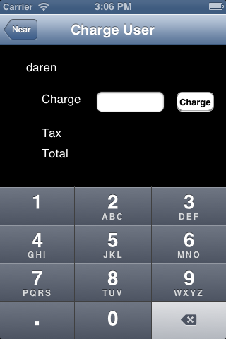
Customer - merchant interaction
Merchant
Customer
Notes:
CHIHI

Slide 37
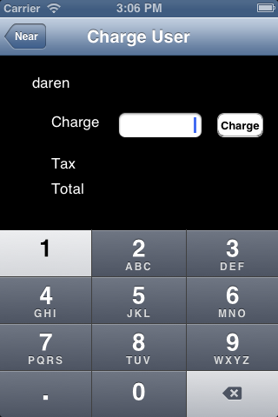
Customer - merchant interaction
Merchant
Customer
Notes:
CHIHI

Slide 38
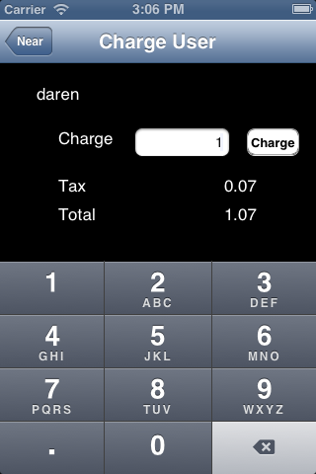
Customer - merchant interaction
Merchant
Customer
Notes:
CHIHI

Slide 39
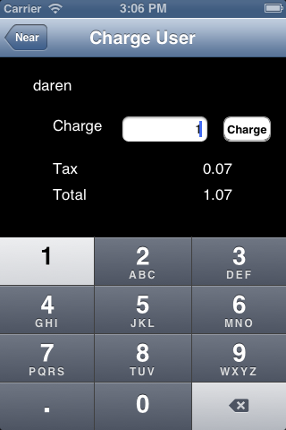
Customer - merchant interaction
Merchant
Customer
Notes:
CHIHI

Slide 40

Customer - merchant interaction
Merchant
Customer
Notes:
CHIHI

Slide 41
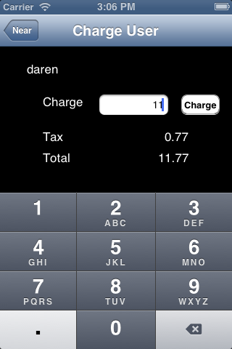
Customer - merchant interaction
Merchant
Customer
Notes:
CHIHI

Slide 42

Customer - merchant interaction
Merchant
Customer
Notes:
CHIHI

Slide 43
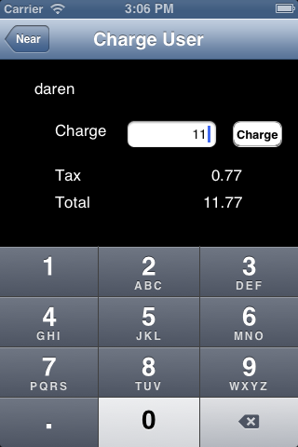
Customer - merchant interaction
Merchant
Customer
Notes:
CHIHI

Slide 44

Customer - merchant interaction
Merchant
Customer
Notes:
CHIHI

Slide 45

Customer - merchant interaction
Merchant
Customer
Notes:
CHIHI

Slide 46

Customer - merchant interaction
Merchant
Customer
Notes:
CHIHI

Slide 47
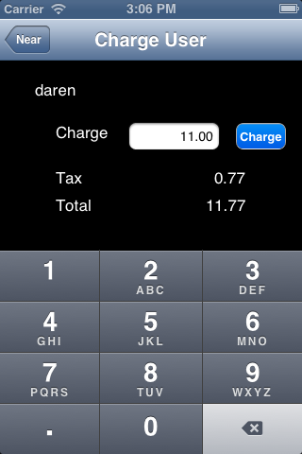
Customer - merchant interaction
Merchant
Customer
Notes:
CHIHI

Slide 48
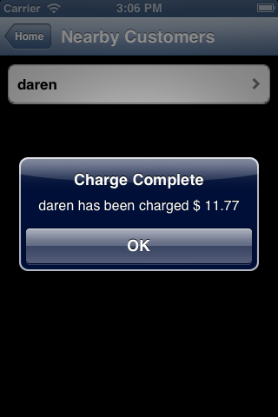
Customer - merchant interaction
Merchant
Customer
Notes:
CHIHI

Slide 49
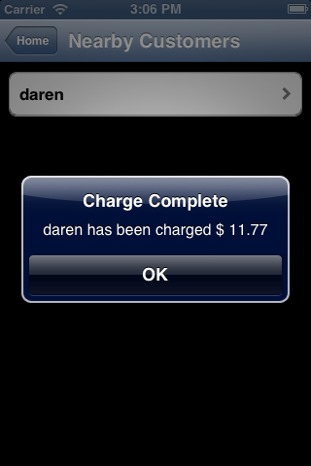
Customer - merchant interaction
Merchant
Customer
Notes:
CHIHI

Slide 50
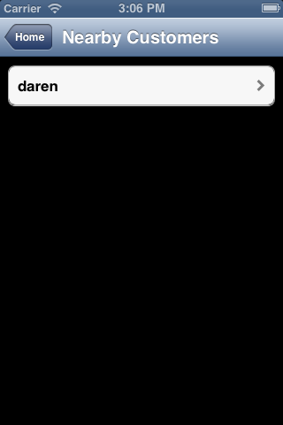
Customer - merchant interaction
Merchant
Customer
Notes:
CHIHI

Slide 51
Customer - merchant interaction
Merchant
Customer
Notes:
CHIHI

Slide 52
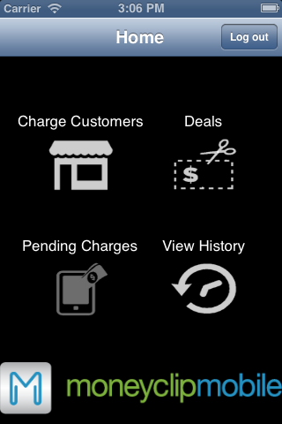
Customer - merchant interaction
Merchant
Customer
Notes:
CHIHI

Slide 53
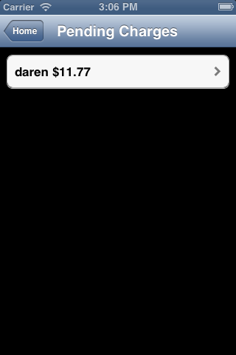
Customer - merchant interaction
Merchant
Customer
Notes:
CHIHI

Slide 54
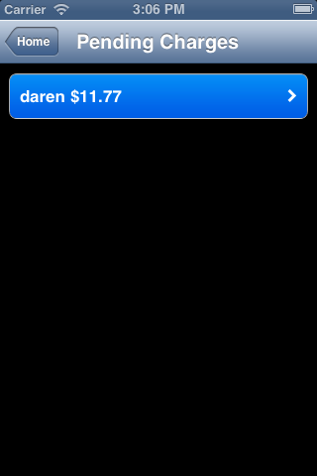
Customer - merchant interaction
Merchant
Customer
Notes:
CHIHI

Slide 55
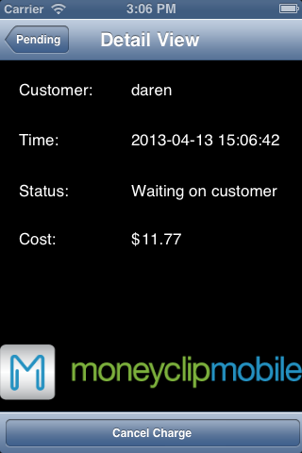
Customer - merchant interaction
Merchant
Customer
Notes:
CHIHI

Slide 56
Customer - merchant interaction
Merchant
Customer
Notes:
CHIHI

Slide 57
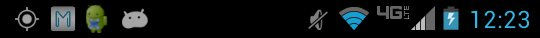
Customer - merchant interaction
Merchant
Customer
Notes:
CHIHI

Slide 58
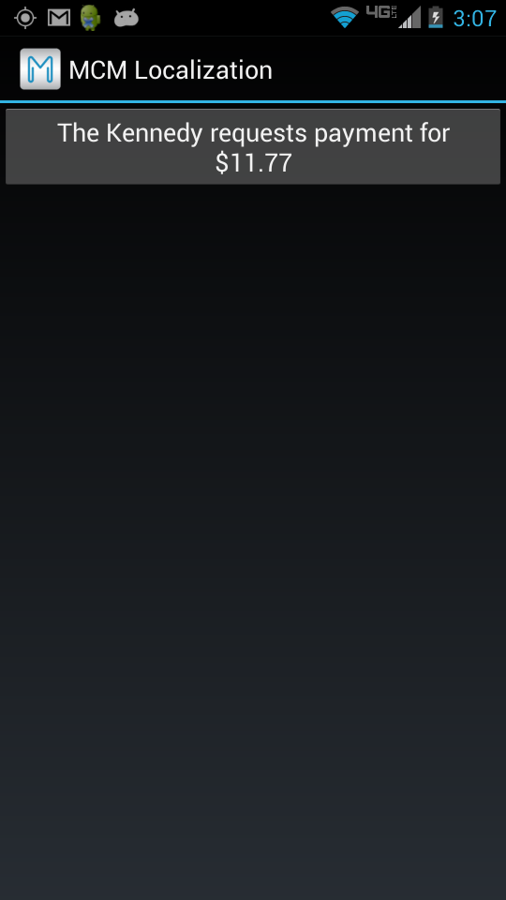
Customer - merchant interaction
Merchant
Customer
Notes:
CHIHI

Slide 59
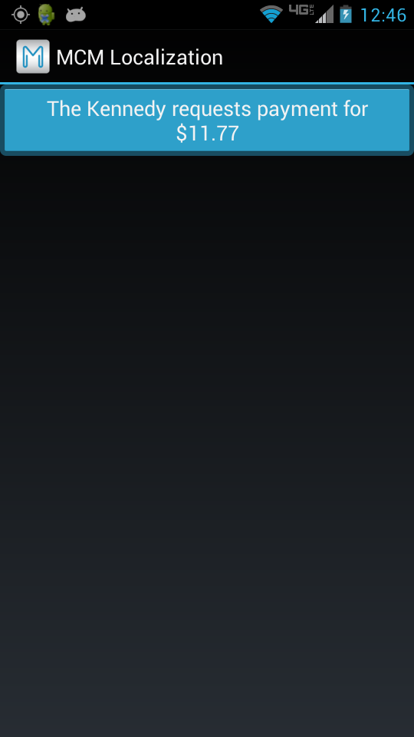
Customer - merchant interaction
Merchant
Customer
Notes:
CHIHI

Slide 60
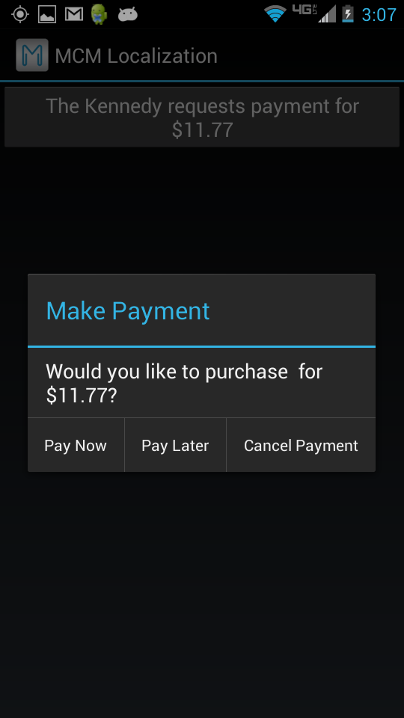
Customer - merchant interaction
Merchant
Customer
Notes:
CHIHI

Slide 61
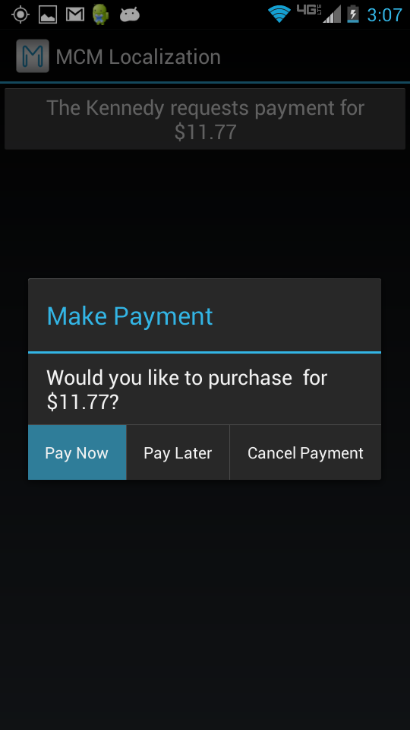
Customer - merchant interaction
Merchant
Customer
Notes:
CHIHI

Slide 62
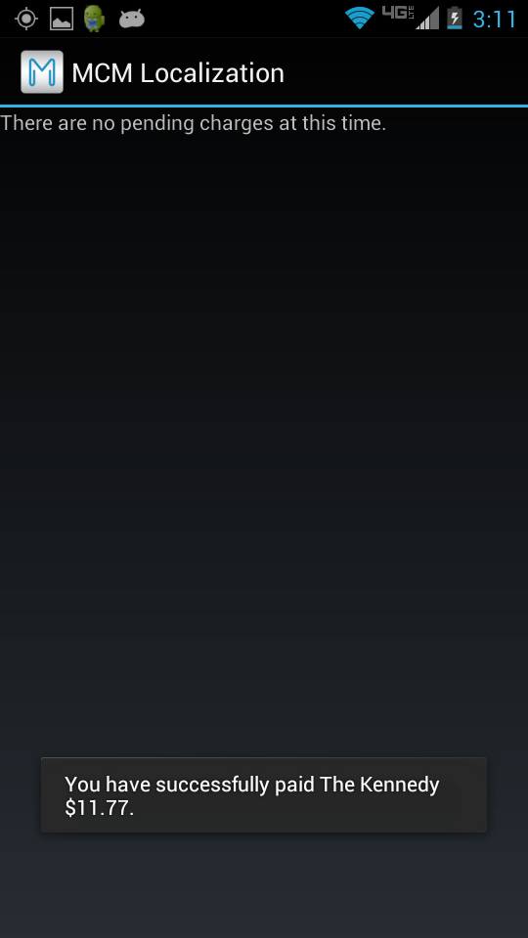
Customer - merchant interaction
Merchant
Customer
Notes:
CHIHI

Slide 63
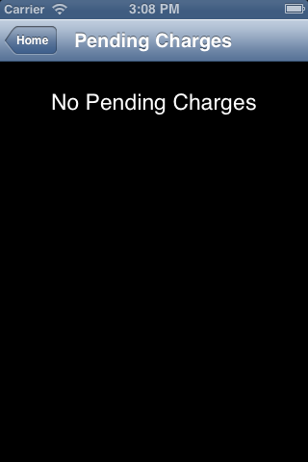
Customer - merchant interaction
Merchant
Customer
Notes:
CHIHI

Slide 64
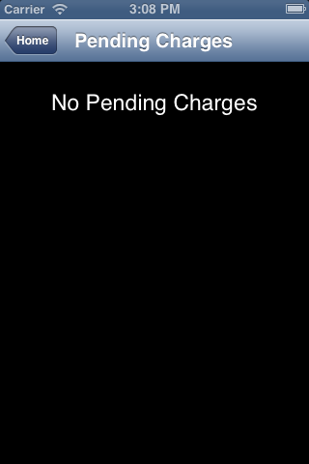
Customer - merchant interaction
Merchant
Customer
Notes:
CHIHI

Slide 65

Customer - merchant interaction
Merchant
Customer
Notes:
CHIHI

Slide 66
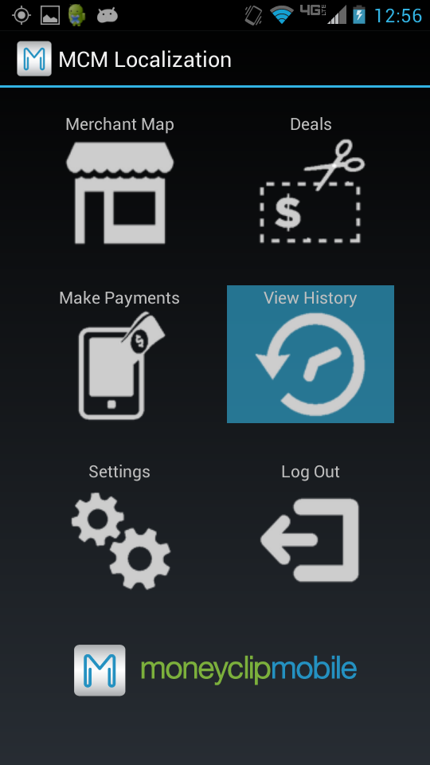
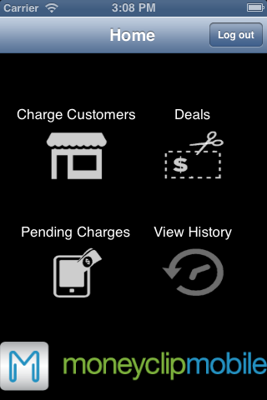
Customer - merchant interaction
Merchant
Customer
Notes:
CHIHI

Slide 67
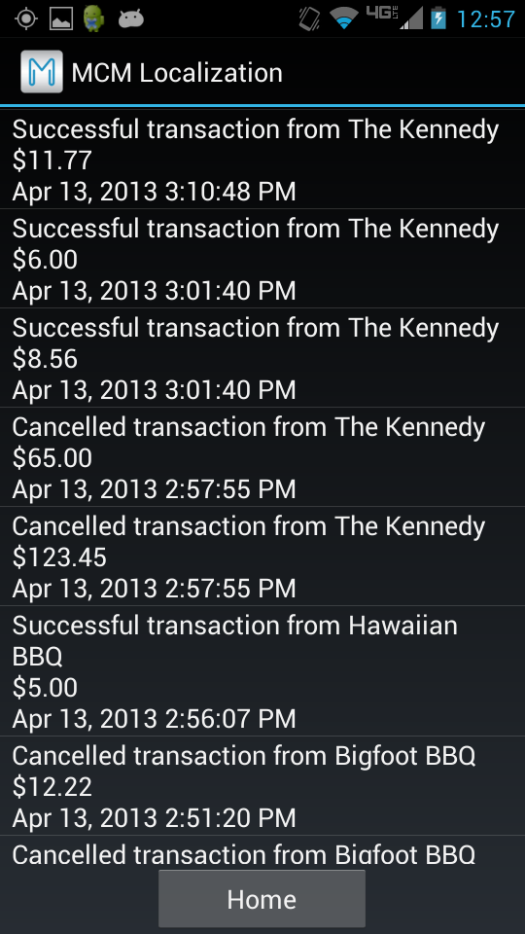
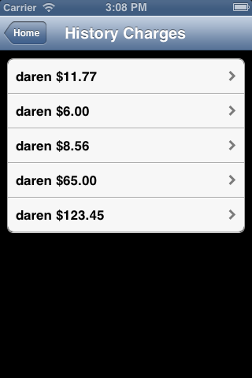
Customer - merchant interaction
Merchant
Customer
Notes:
CHIHI

Slide 68
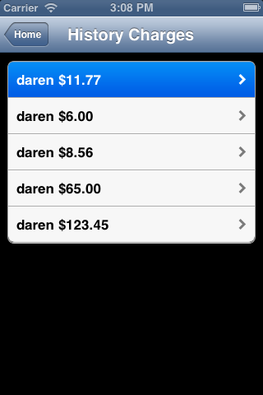
Customer - merchant interaction
Merchant
Customer
Notes:
CHIHI

Slide 69
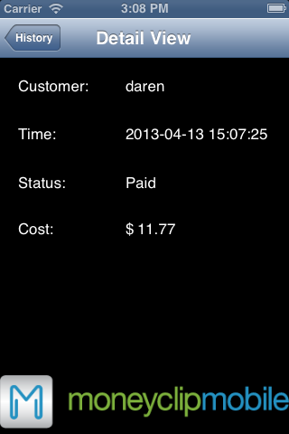
Customer - merchant interaction
Merchant
Customer
Notes:
CHIHI

Slide 70

PART 2: targeted deals

Slide 71
Targeted deals
Customer
Notes:
CHIHI

Slide 72
Targeted deals
Customer
Notes:
CHIHI

Slide 73
Targeted deals
Customer
Notes:
CHIHI

Slide 74
Targeted deals
Customer
Notes:
CHIHI

Slide 75
Targeted deals
Customer
Notes:
CHIHI

Slide 76
Targeted deals
Customer
Notes:
CHIHI

Slide 77
Targeted deals
Customer
Notes:
CHIHI

Slide 78
Targeted deals
Customer
Notes:
CHIHI

Slide 79
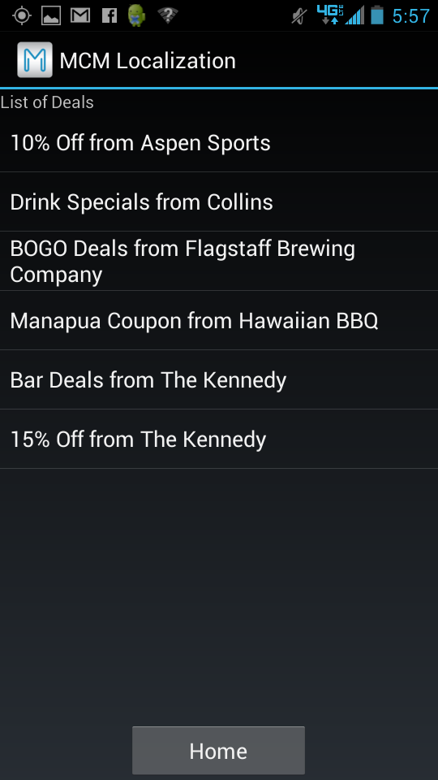
Targeted deals
Customer
Notes:
CHIHI

Slide 80

Targeted deals
Customer
Notes:
CHIHI

Slide 81

Targeted deals
Customer
Notes:
CHIHI

Slide 82

Targeted deals
Customer
Notes:
CHIHI

Slide 83
Solution Overview
Design
Implementation
Testing
Conclusion
testing
Chihiro Sasaki

Slide 84
Integration testing
The web services have been unit tested. This tests some of the database structure as well as the query syntax.
GPS Accuracy
Notes:
kimi

Slide 85


User Testing
40 volunteer test users
3 stages of testing
4 apps
Notes:
blayne

Slide 86

User testing: Lessons learned
Consistent app behavior
Expected functionalities

Slide 87
Data transfer benchmarking
Action | Android (KB) |  | iPhone (KB)
 | Receive | Transmit | Receive | Transmit
Log in | 2.322 | 3.100 | 0.433 | 0.592
Merchant Map | 1.942 | 1.912 | 1.804 | 1.703
Deals | 3.328 | 1.002 | 1.692 | 0.571
Pay Charge | 0.942 | 1.740 | 0.298 | 0.283
View History | 2.070 | 0.872 | 4.226 | 0.570
Logout | 0.000 | 0.000 | 0.000 | 0.000
Notes:
kimi

Slide 88
Application Sizes
iPhone Merchant: 5.300 MB
iPhone Customer: 5.000 MB
Android Merchant: 0.676 MB
Android Customer: 1.020 MB
Notes:
kimi

Slide 89

Schedule
Notes:
As you can see from the Gantt chart, the documentation and the testing phases overlap very much with the implementation phase. For documentation of the code itself, we are using Doxygen, and we are developing higher-level documentation throughout our implentation phase.
For testing, we are doing simple component testing for all functions that we write, and we’re also going to perform integration testing as well as user testing during later phases.

Slide 90
Solution Overview
Design
Implementation
Testing
Conclusion
Conclusion
Chihiro Sasaki

Slide 91
Conclusion
Combine functionality of PayPal, Square, and direct ads/coupons using localization
Skeleton:
Database
Mobile apps
Website
Localization for charging users
Need direct advertisements
Notes:
The MCM localization project is going to combine the moneyless mobile transactions like PayPal and Square, with the addition of direct advertisements and coupons using localization. We currently have the skeleton of the database, both mobile apps, and the website. The first component of localization of the merchant and customer interaction is completed, and we are currently working on direct advertisements as well as testing and thorough documentation.

Slide 92
acknowledgments
Dr. Joshua Cros
Dr. John Georgas
Dr. Wolf-Dieter Otte
Dr. Eck Doerry
User Testing Volunteers
Notes:
The MCM localization project is going to combine the moneyless mobile transactions like PayPal and Square, with the addition of direct advertisements and coupons using localization. We currently have the skeleton of the database, both mobile apps, and the website. The first component of localization of the merchant and customer interaction is completed, and we are currently working on direct advertisements as well as testing and thorough documentation.

Slide 93
questions

Slide 94
GOOgle Maps API
Google Maps API limit
25,000 map loads per day for free
2,500 requests per day for geocoding
Google Maps API for Business
$10,000 per year
100,000 requests per day for geocoding

Slide 95
Content Filter
Different types of filters
Inappropriate age content
Inappropriate language
Inappropriate number of ads pushed at one time

